Slide 1

MIXED EFFECTS OF RANDOM FOREST
TEAM 01
PONSWARNALAYA RAVICHANDRAN

Slide 2
INTRODUCTION:
class merf.
This is the core class to instantiate, train, and predict using a mixed effects random forest model. It roughly adheres to the sklearn estimator API.
Note that the user must pass in an already instantiated fixed_effects_model that adheres to the sklearn regression estimator API, i.e. must have a fit() and predict() method defined.

Slide 3
It assumes a data model of the form: 𝑦=𝑓(𝑋)+𝑏𝑖𝑍+𝑒
y is the target variable. The current code only supports regression for now, e.g. continuously varying scalar value
X is the fixed effect features. Assume p dimensional
f(.) is the nonlinear fixed effects mode, e.g. random forest
Z is the random effect features. Assume q dimensional.
e is iid noise ~N(0, sigma_e²)
i is the cluster index. Assume k clusters in the training
bi is the random effect coefficients. They are different per cluster i but are assumed to be drawn from the same distribution ~N(0, Sigma_b) where Sigma_b is learned from the data.

Slide 4




Steps involved:
Installing the necessary libraries and dataset.
Importing the dataset and the required parameters/indexes.
Data preprocessing (checking and cleaning the missing/noisy data)
Log transformation (CO2 per capita)

Slide 5



1. STUDY OF HETEROGENEITY IN RELATION BETWEEN THE RESPONSE AND COVARIATES.
Imported the sns library
Correlation
Correlation matrix
Scatterplots between the response and covariate.

Slide 6
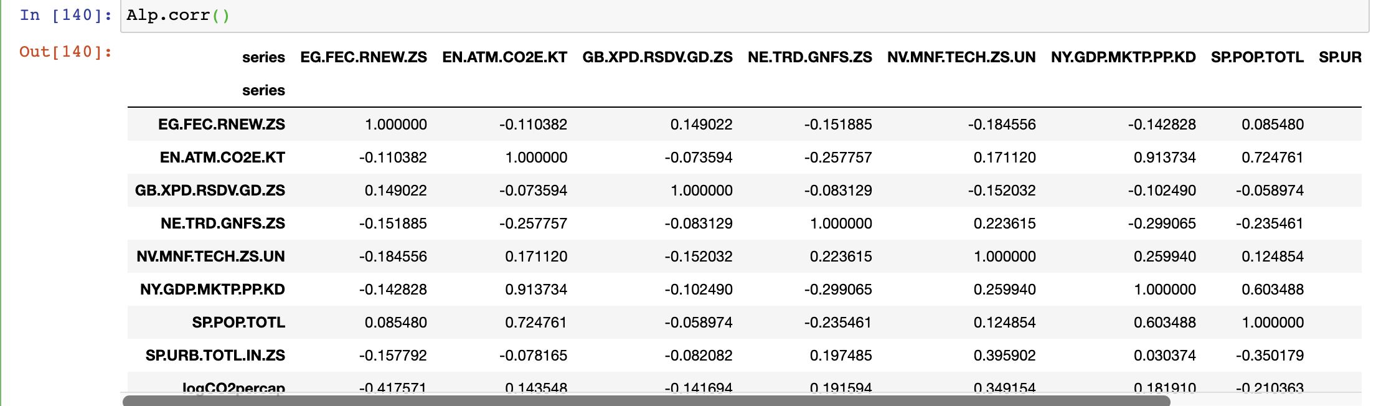
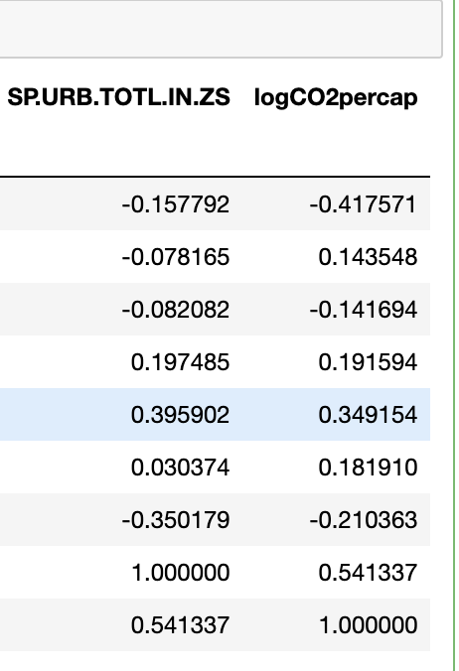
CORRELATION

Slide 7
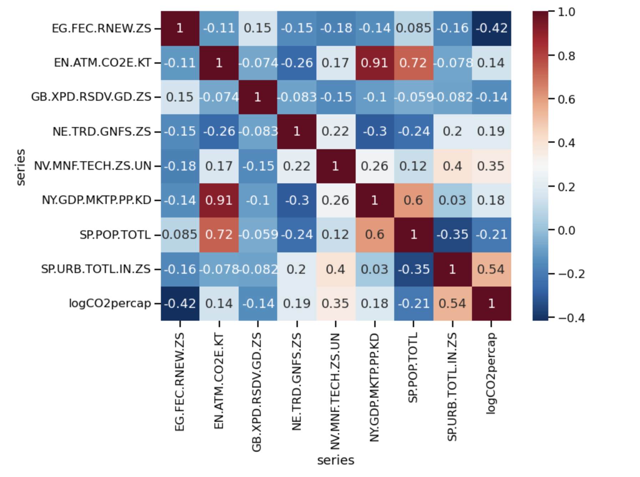
CORR-MATRIX

Slide 8
BUILD A MODEL FOR PREDICTION
Mixed effects of random forest
Splitting the data into train and test
Training the model
Testing the model

Slide 9
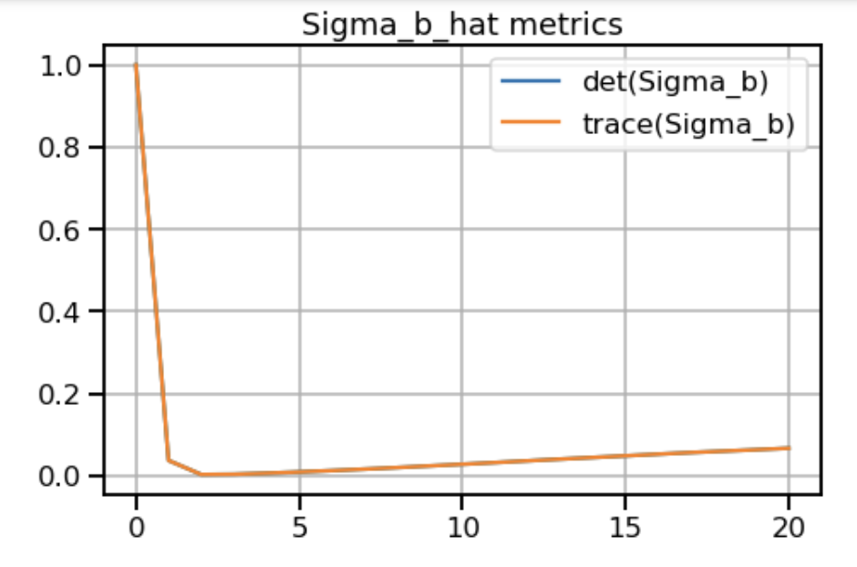
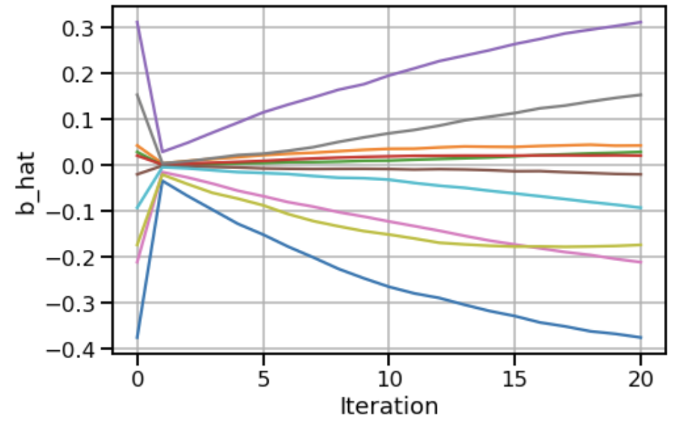
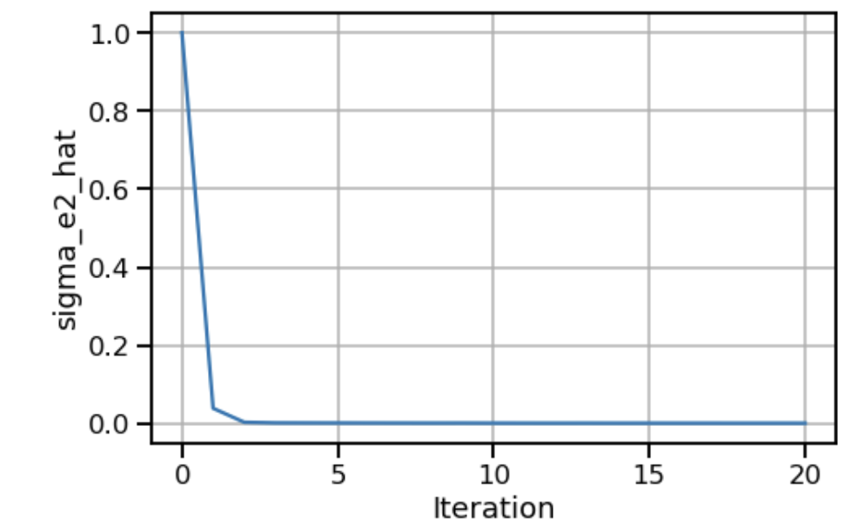
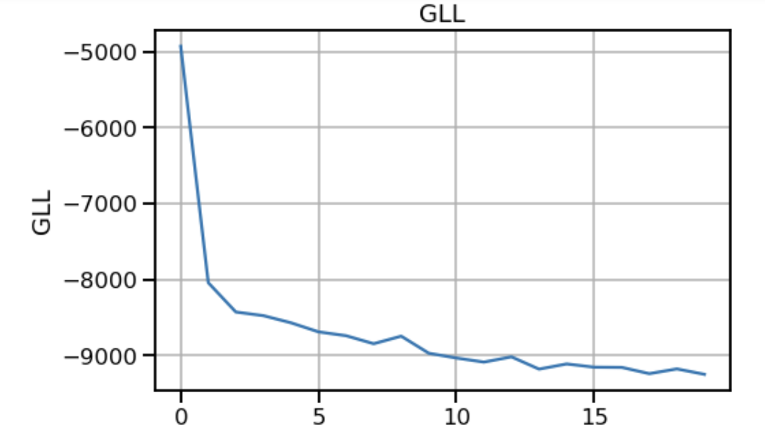
OUTPUT:

Slide 10
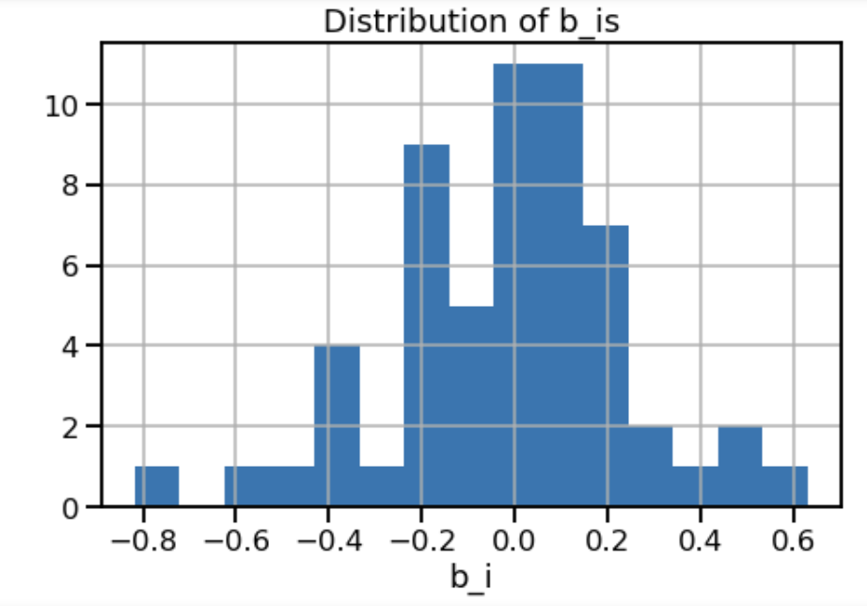

Slide 11

PARAMETERS USED:
Max_iterations: maximum no of iterations to run MERF
GLL : Generalised likelihood(which can be computed at every iteration, is a measure of training loss. As the GLL goes down the fit improves. Once it flattens out we can usually stop iterating .
Sigma_b_& Sigma_e2 metrics
b_hat
Distribution of bi_

Slide 12
SUMMARY:
STEP01
Installing and importing the libraries, dataset
STEP02
Data Preprocessing
STEP03
Data analyzing
STEP04
STEP05
TASK02 & CONCLUSION
Task01

Slide 13


Thank You
PON SWARNALAYA RAVICHANDRAN
swarnalaya177@gwu.edu

